Slide 1
CS118 – Programming Fundamentals
Lecture # 11
Monday, September 30, 2019
FALL 2019
FAST – NUCES, Faisalabad Campus
Course Instructor:
Ebad Majeed
Slides Cresit:
Rizwan Ul Haq

Slide 2
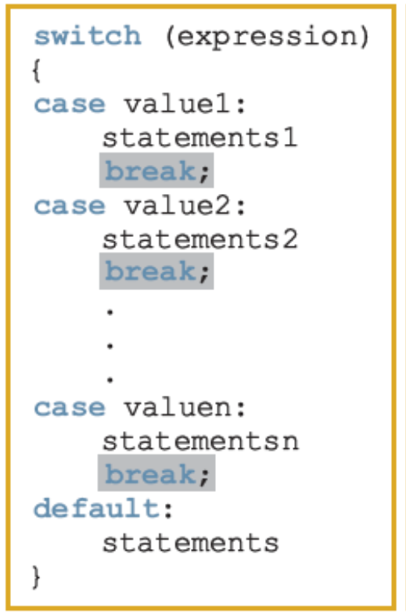
switch Structures
switch structure: Alternate to if-else
switch (integral) expression is evaluated first
Value of the expression determines which corresponding action is taken
Expression is sometimes called the selector

Slide 3
switch Structures (cont'd.)

Slide 4
switch Structures (cont'd.)
One or more statements may follow a case label
Braces are not needed to turn multiple statements into a single compound statement
The break statement may or may not appear after each statement
switch, case, break, and default are reserved words

Slide 5
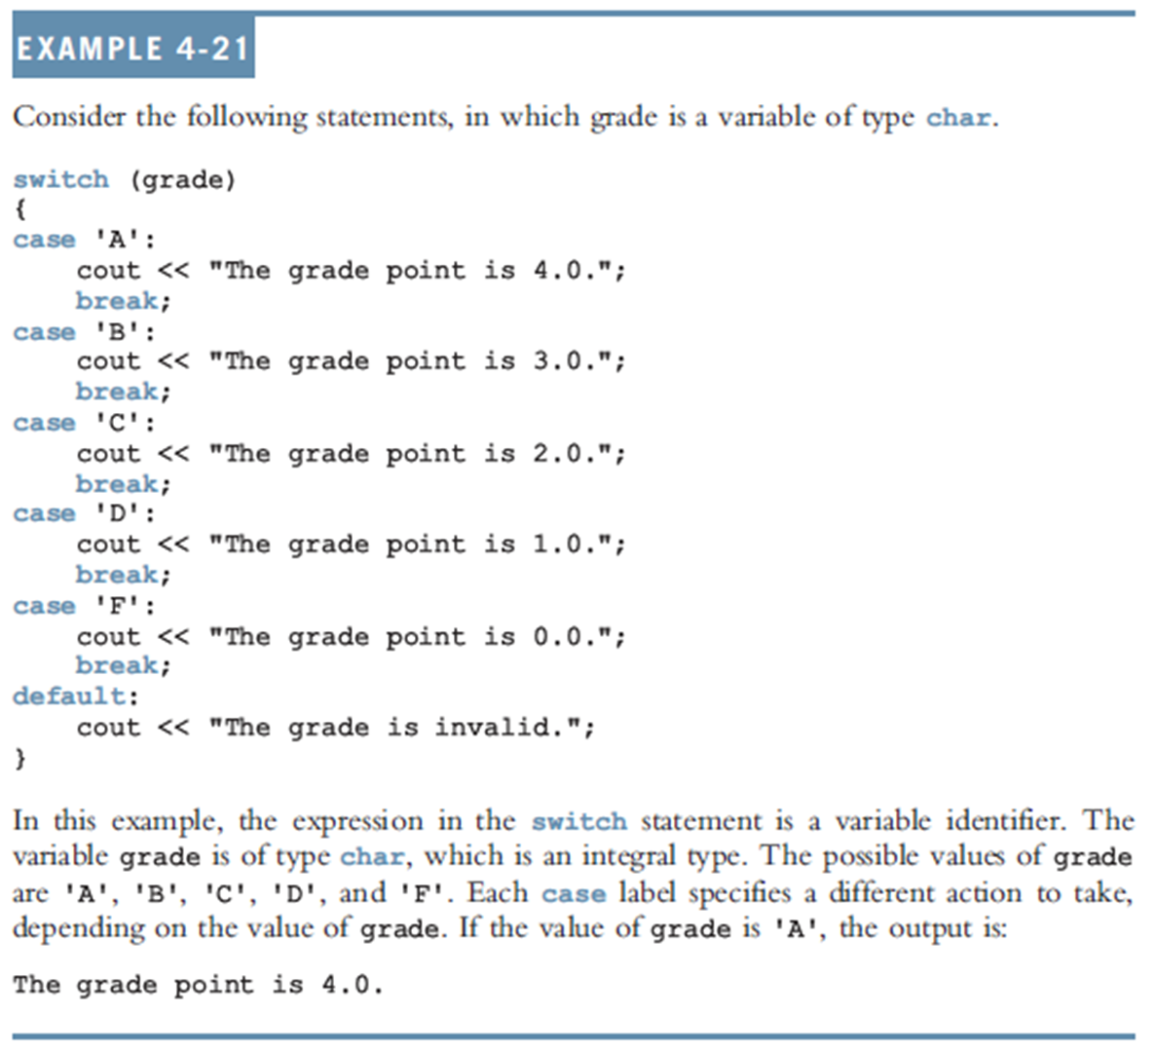

Slide 6
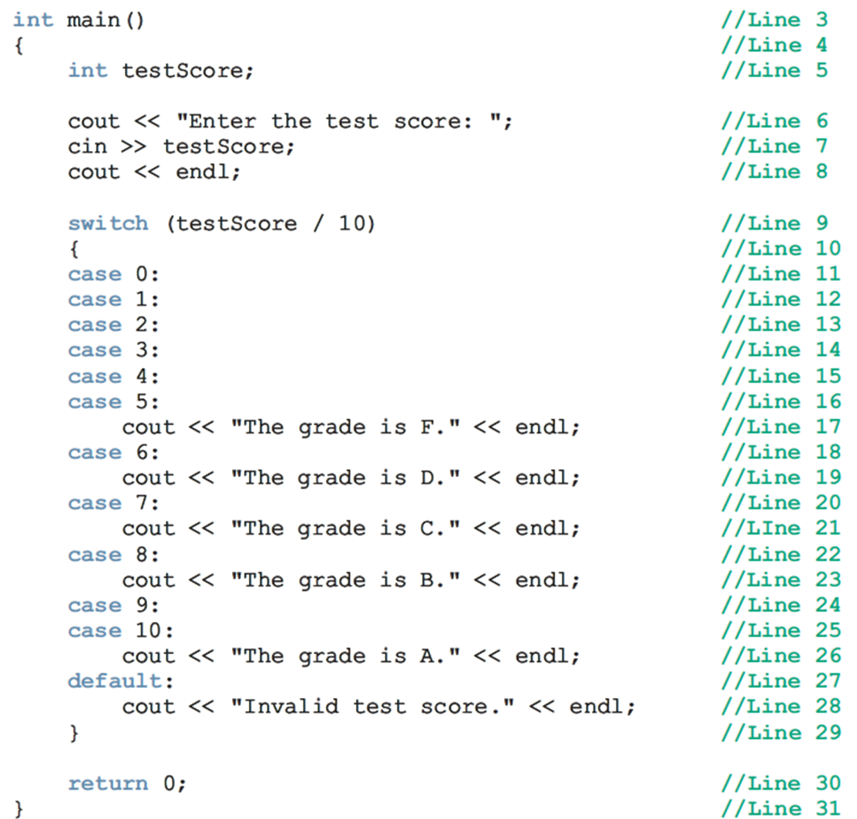

Slide 7
Output = ?
#include<iostream>
using namespace std;
int main(){
int number;
cout << "Enter a number in the range 0 - 7 : " ;
cin >> number;
cout << "The number you entered is = " << number << endl;
switch(number){
case 0:
case 1:
cout << "Learning to use " ;
case 2:
cout << "C++'s " ;
case 3:
cout <<"switch structure." << endl;
break;
case 4:
break;
case 5:
cout << "This program shows the effect " ;
case 6:
case 7:
cout << "of break statement." << endl;
break;
default:
cout <<"The number is out of range." << endl;
}
cout << "Out of the switch structure" << endl;
return 0;
}
0
2
4
5
7
8

Slide 8
Avoiding Bugs by Avoiding Partially Understood Concepts and Techniques: Revisited
To output results correctly
The switch structure must include a break statement after each cout statement

Slide 9
Terminating a Program with the assert Function
Certain types of errors that are very difficult to catch can occur in a program
Example: Division by zero can be difficult to catch using any of the programming techniques examined so far
The predefined function, assert, is useful in stopping program execution when certain elusive errors occur

Slide 10

The assert Function (cont'd.)
Syntax:
expression is any logical expression
If expression evaluates to true, the next statement executes
If expression evaluates to false, the program terminates and indicates where in the program the error occurred
To use assert, include cassert header file

Slide 11
The assert Function (cont'd.)
assert is useful for enforcing programming constraints during program development
After developing and testing a program, remove or disable assert statements
The preprocessor directive #define NDEBUG must be placed before the directive #include <cassert> to disable the assert statement

Slide 12
assert example
#include <iostream>
//#define NDEBUG
#include <cassert>
using namespace std;
int main()
{
int den, num;
cout << "Enter two integers" << endl;
cin >> num >> den ;
assert(num !=0) ;
cout << "Moving forward" << endl;
cout << "num / den = " << num / den << endl ;
return 0;
}

Slide 13
Complete Example @ HOME For practice of students

Slide 14
Programming Example: Cable Company Billing
This programming example calculates a customer’s bill for a local cable company
There are two types of customers:
Residential
Business
Two rates for calculating a cable bill:
One for residential customers
One for business customers

Slide 15
Programming Example: Rates
For residential customer:
Bill processing fee: $4.50
Basic service fee: $20.50
Premium channel: $7.50 per channel
For business customer:
Bill processing fee: $15.00
Basic service fee: $75.00 for first 10 connections/$5.00 for each additional one
Premium channel cost: $50.00 per channel for any number of connections

Slide 16
Programming Example: Requirements
Ask user for account number and customer code
Assume R or r stands for residential customer and B or b stands for business customer

Slide 17
Programming Example: Input and Output
Input:
Customer account number
Customer code
Number of premium channels
For business customers, number of basic service connections
Output:
Customer’s account number
Billing amount

Slide 18
Programming Example: Program Analysis
Purpose: calculate and print billing amount
Calculating billing amount requires:
Customer for whom the billing amount is calculated (residential or business)
Number of premium channels to which the customer subscribes
For a business customer, you need:
Number of basic service connections
Number of premium channels

Slide 19
Programming Example: Program Analysis (cont'd.)
Data needed to calculate the bill, such as bill processing fees and the cost of a premium channel, are known quantities
The program should print the billing amount to two decimal places

Slide 20
Programming Example: Algorithm Design
Set precision to two decimal places
Prompt user for account number and customer type
If customer type is R or r
Prompt user for number of premium channels
Compute and print the bill
If customer type is B or b
Prompt user for number of basic service connections and number of premium channels
Compute and print the bill

Slide 21
Programming Example: Variables and Named Constants
int accountNumber ; //Variable to store the customer's
//Account number
char customerType ; //Variable to store customer type
int numOfPremiumChannels ; //Variable to store the number of premium
//Channels to which the customer subscribed
int numOfBasicSerCon ; //Variable to store the number of basic
//Channels to which the customer subscribed
double amountDue ; //Variable to store the billing amount
//Named Constants - Residential customers
const double RES_BILL_PROC_FEE = 4.5 ;
const double RES_BASIC_SERV_COST = 20.5 ;
const double RES_COST_PREM_CHANNEL = 7.5 ;
//Named Constants - Business customers
const double BUS_BILL_PROC_FEE = 15.00 ;
const double BUS_BASIC_SERV_COST = 75.0 ;
const double BUS_BASIC_CONN_COST = 5.0 ;
const double BUS_COST_PREM_CHANNEL = 50.0 ;

Slide 22
Programming Example: Formulas
Billing for residential customers:
amountDue = RES_BILL_PROC_FEES +
RES_BASIC_SERV_COST +
numOfPremChannels *
RES_COST_PREM_CHANNEL;

Slide 23
Programming Example: Formulas (cont'd.)
Billing for business customers:
if (numOfBasicServConn <= 10)
amountDue = BUS_BILL_PROC_FEES +
BUS_BASIC_SERV_COST +
numOfPremChannels *
BUS_COST_PREM_CHANNEL ;
else
amountDue = BUS_BILL_PROC_FEES +
BUS_BASIC_SERV_COST +
(numOfBasicServConn - 10) *
BUS_BASIC_CONN_COST +
numOfPremChannels *
BUS_COST_PREM_CHANNEL ;

Slide 24
Programming Example: Main Algorithm
Output floating-point numbers in fixed decimal with decimal point and trailing zeros
Output floating-point numbers with two decimal places and set the precision to two decimal places
Prompt user to enter account number
Get customer account number
Prompt user to enter customer code
Get customer code

Slide 25
Programming Example: Main Algorithm (cont'd.)
If the customer code is r or R,
Prompt user to enter number of premium channels
Get the number of premium channels
Calculate the billing amount
Print account number and billing amount

Slide 26
Programming Example: Main Algorithm (cont'd.)
If customer code is b or B
Prompt user to enter number of basic service connections
Get number of basic service connections
Prompt user to enter number of premium channels
Get number of premium channels
Calculate billing amount
Print account number and billing amount

Slide 27
Programming Example: Main Algorithm (cont'd.)
If customer code is other than r, R, b, or B, output an error message

Slide 28
Another Programming Example
1 // Example
2 // Using if statements, relational
3 // operators, and equality operators.
4 #include <iostream>
5
6 using std::cout; // program uses cout
7 using std::cin; // program uses cin
8 using std::endl; // program uses endl
9
10 // function main begins program execution
11 int main()
12 {
13 int num1; // first number to be read from user
14 int num2; // second number to be read from user
15
16 cout << "Enter two integers, and I will tell you\n"
17 << "the relationships they satisfy: ";

Slide 29
18 cin >> num1 >> num2; // read two integers
19
20 if ( num1 == num2 )
21 cout << num1 << " is equal to " << num2 << endl;
22
23 if ( num1 != num2 )
24 cout << num1 << " is not equal to " << num2 << endl;
25
26 if ( num1 < num2 )
27 cout << num1 << " is less than " << num2 << endl;
28
29 if ( num1 > num2 )
30 cout << num1 << " is greater than " << num2 << endl;
31
32 if ( num1 <= num2 )
33 cout << num1 << " is less than or equal to "
34 << num2 << endl;
35
36 if ( num1 >= num2 )
37 cout << num1 << " is greater than or equal to "
38 << num2 << endl;
39
40 return 0; // indicate that program ended successfully
41
42 } // end function main

Slide 30
Sample Run 1
Enter two integers, and I will tell you
the relationships they satisfy: 35 17
35 is not equal to 17
35 is greater than 17
35 is greater than or equal to 17

Slide 31
Sample Run 2
Enter two integers, and I will tell you
the relationships they satisfy: 10 10
10 is equal to 10
10 is less than or equal to 10
10 is greater than or equal to 10

Slide 32
Summary
Control structures alter normal control flow
Most common control structures are selection and repetition
Relational operators: ==, <, <=, >, >=, !=
Logical expressions evaluate to 1 (true) or 0 (false)
Logical operators: ! (not), && (and), || (or)

Slide 33
Summary (cont'd.)
Two selection structures: one-way selection and two-way selection
The expression in an if or if...else structure is usually a logical expression
No stand-alone else statement in C++
Every else has a related if
A sequence of statements enclosed between braces, { and }, is called a compound statement or block of statements

Slide 34
Summary (cont'd.)
Using assignment in place of the equality operator creates a semantic error
switch structure handles multiway selection
break statement ends switch statement
Use assert to terminate a program if certain conditions are not met

Slide 35
Questions

